Slide 1
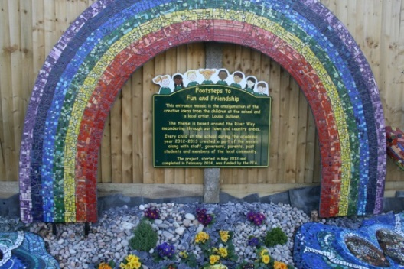
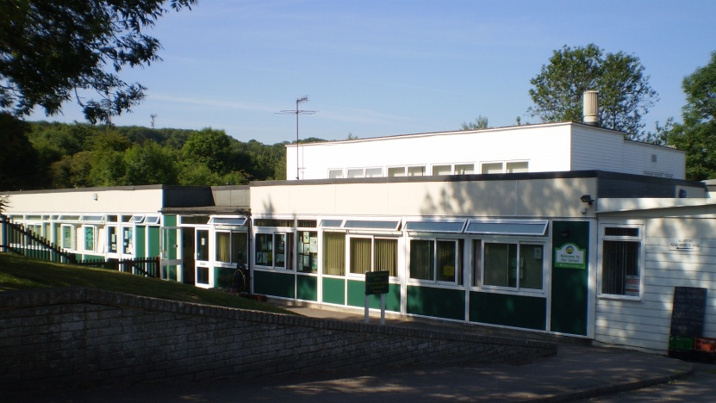

Coffee Morning September 2026
Welcome to
Onslow Infant School

Slide 2
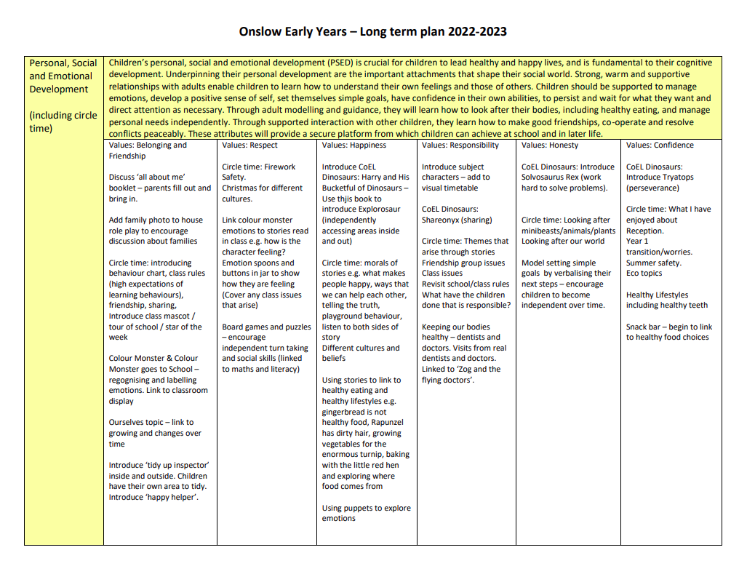
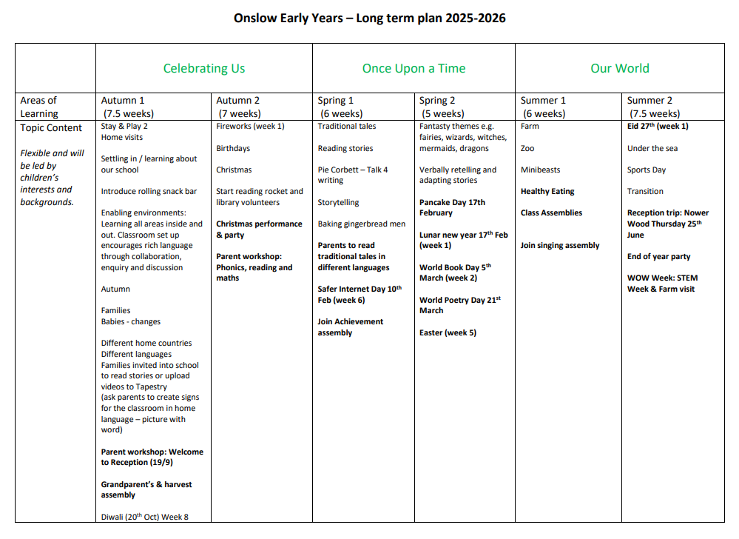
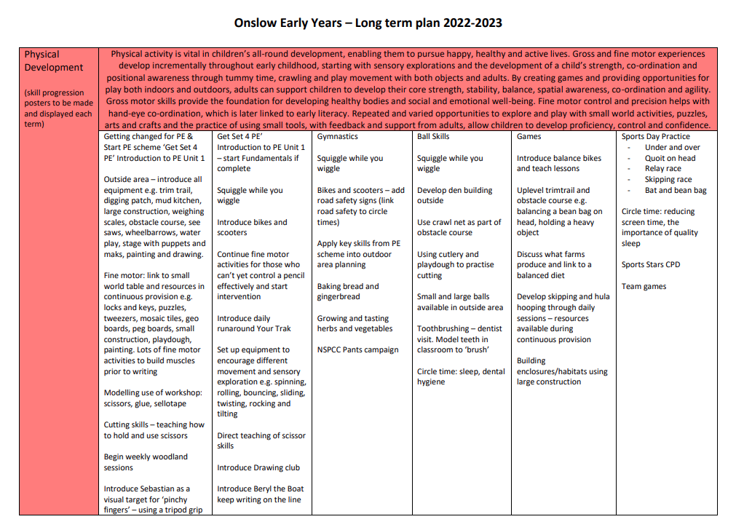
Our Learning
You can find the long term planning on the school website:
https://www.onslow.surrey.sch.uk/early-years-curriculum

Slide 3
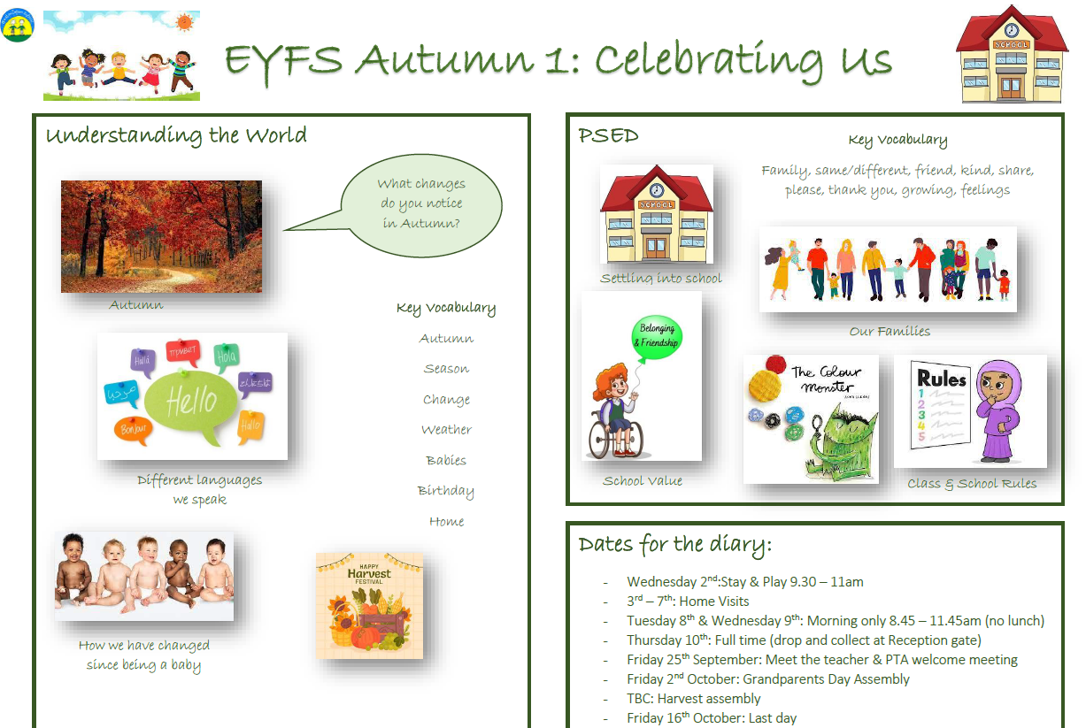
Autumn 1 learning
This will come out every half term (website and Tapestry) to show you what your child will be learning.

Slide 4

Tapestry
We will share key WOW moments that we see your child having in school.
We value quality over quantity so some weeks you may not get anything.
Please do comment and like posts, but questions need to be with the teachers on the gate or via email (yearR@onslow.surrey.sch.uk).
Please add key WOW moments your child has at home so we can share these in class.
We occasionally set topic enrichment too e.g. go on an Autumn walk and upload a photo.
Please check it weekly.

Slide 5
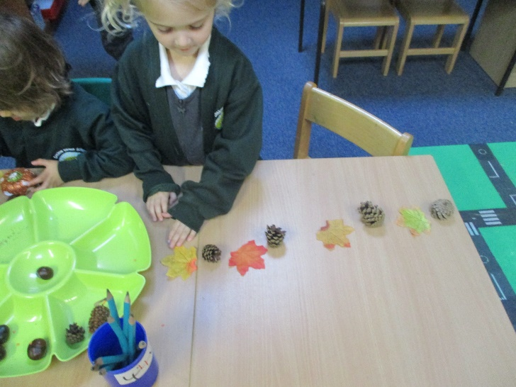
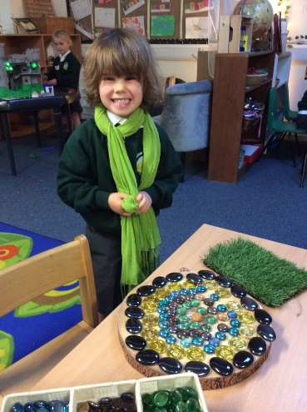
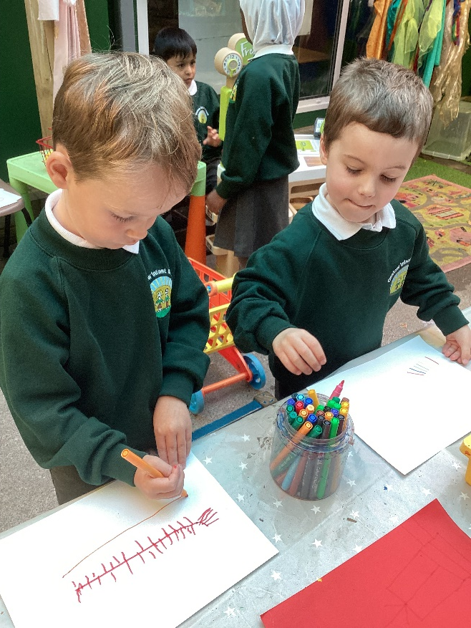
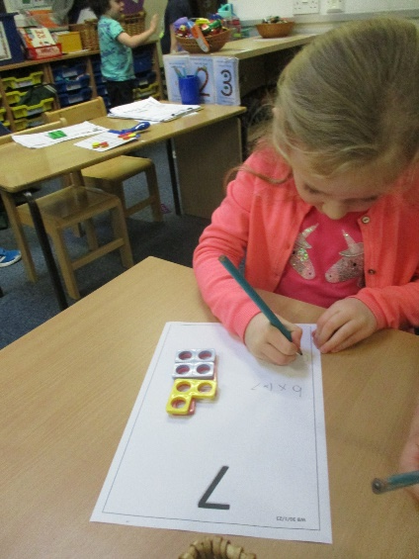
Do they just play all day?
Our classrooms and outside areas are set up carefully to enable children to ‘play’ within the 7 areas of learning.
We use carpet times to teach skills and knowledge and then the children have a go at practising these during ‘choosing time’.
We also do weekly adult led group sessions e.g. writing, maths.

Slide 6
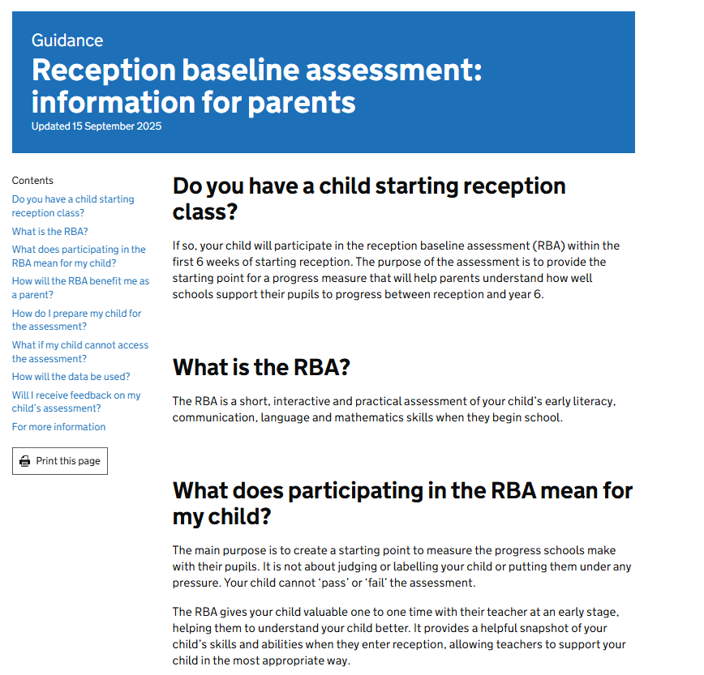
Baseline Assessment
We are currently doing the government baseline assessments with all children.
We are also doing our own initial teacher assessments to find out your child’s starting points.

Slide 7
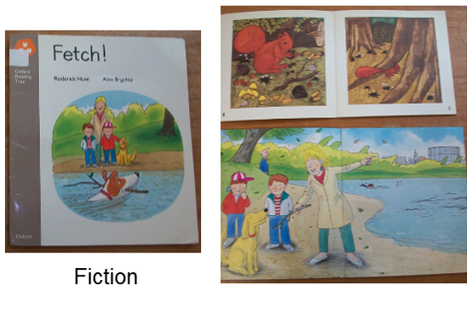
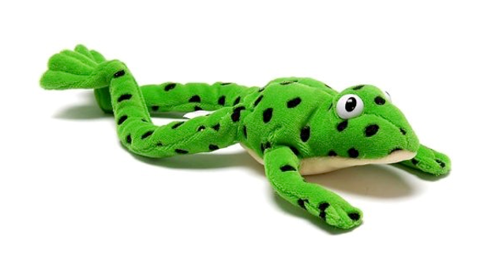
Reading Books
Lilac books have been sent home. They have no words - please encourage your child to ‘tell’ the story using the pictures (comprehension).
Children get used to the process of changing books 3x weekly.
Begin to ‘Fred talk’ with your child e.g. sound out objects in their books or things around the house:
c-a-t
d-o-g
c-oa-t
Phonics videos on Tapestry each week to watch at home
Once children know the first 12 sounds, they will bring home pink books with words to read.
Notes:
*know that print is read from left to right and top to bottom
characters, sequence of events, story language
How info can be found in n-f bks
, leading to sentences
*to represent sounds correctly in writing
*to attempt writing for a variety of purposes

Slide 8
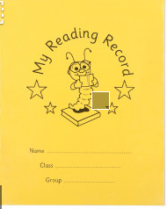

Reading Books
Reading for pleasure books changed Monday, Wednesday Friday.
Staff and parent/carer comments.
Read daily!
Enjoyment is key.
Library books later this term.
Notes:
*know that print is read from left to right and top to bottom
characters, sequence of events, story language
How info can be found in n-f bks
, leading to sentences
*to represent sounds correctly in writing
*to attempt writing for a variety of purposes

Slide 9
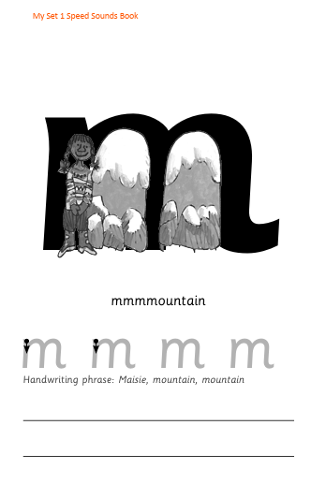
Phonics in Reception
Homework booklets
Letter formation is key – no more capitals or ball and stick letters!
They need to form them in one continuous flow to help with later joined up writing (which starts in Y1).
We practise, practise, practise!
3 - 4 a week once established in class.
Your child completes 3-4 pages of homework in their booklet each week – we will tell you when to do each sound. DO NOT allow your child to complete sounds we have not yet taught.

Slide 10
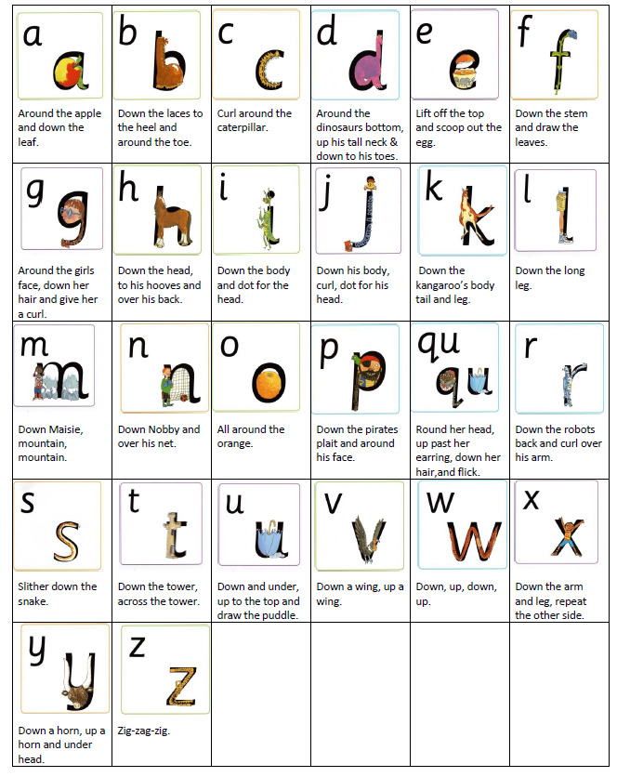
Phonics in Reception
This term we will teach your child a sound for each letter of the alphabet.
Each sound has a picture to help them remember it.
Each sound also has a phrase to help them remember how to write it.

Slide 11
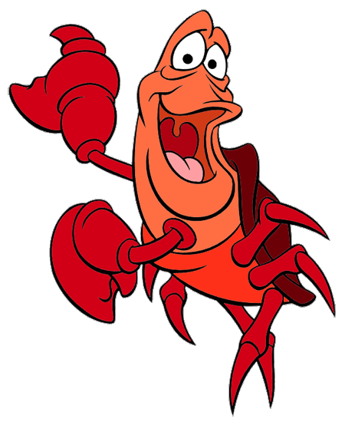
Writing
Your child has been introduced to Sebastian who is a visual reminder to use ‘pinchy fingers’.
We are starting to encourage a 3 finger grip whenever they draw, write or mark make.
We say “1 2 3, pinch with me” as they pick up a pencil (video on Tapestry to watch).
Our first aim is to make sure all children can write their name. Please practise at home using the name cards we gave you.
Lots of fine motor games will help to strengthen their fingers and make them better at writing:
  Lego
  Tweezers
  Playdough
  Threading
  Peg boards
  Puzzles

Slide 12
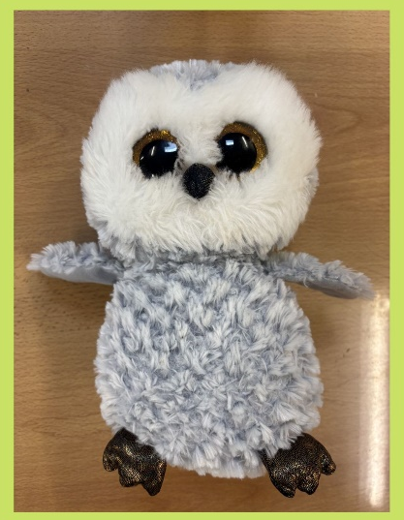
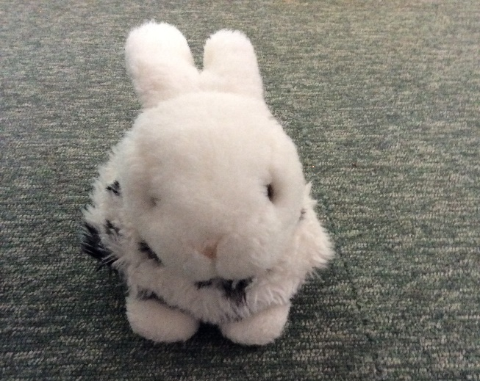
Class Mascots
Ollie the Owl
Rosie Rabbit
Star of the week certificate – every Friday.
Chosen at random (everyone gets a turn).
That child will bring home the class mascot and a golden bookbag of books for the weekend.
Share the books together at home.
Please post photos on Tapestry for your child to show in class.
Notes:
*know that print is read from left to right and top to bottom
characters, sequence of events, story language
How info can be found in n-f bks
, leading to sentences
*to represent sounds correctly in writing
*to attempt writing for a variety of purposes

Slide 13
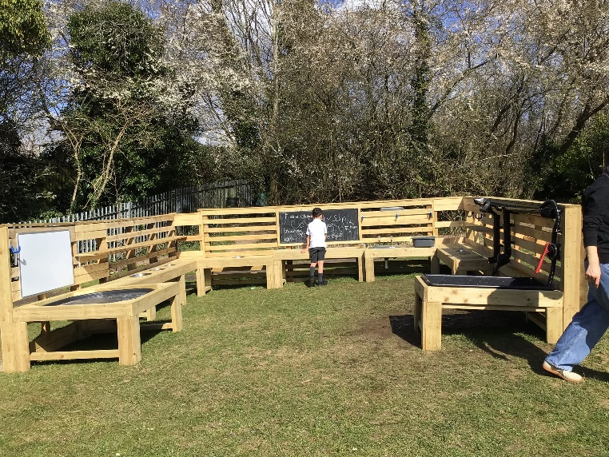
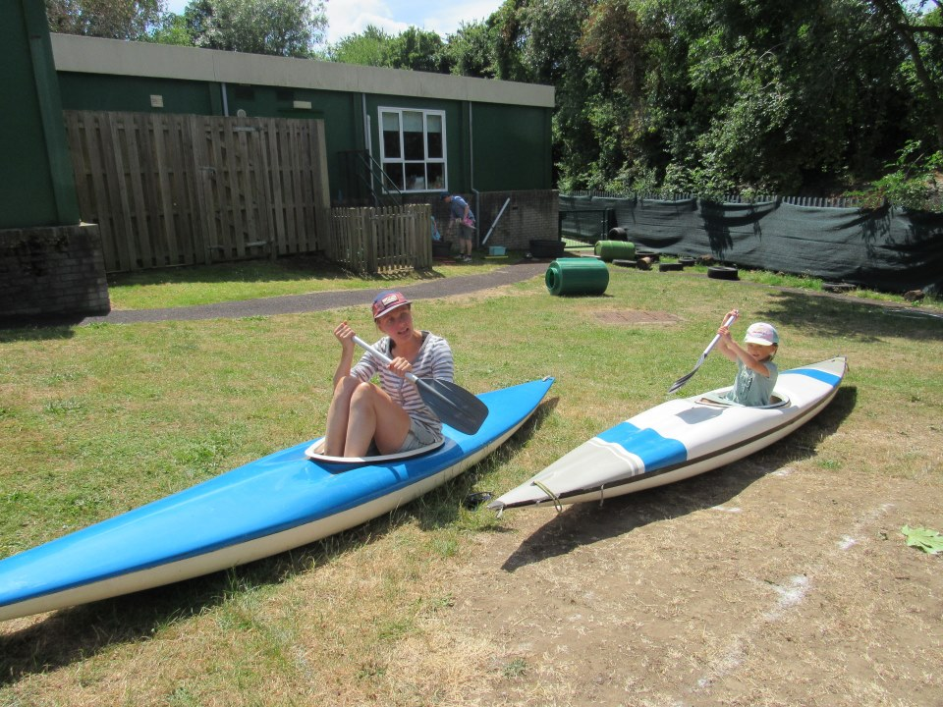
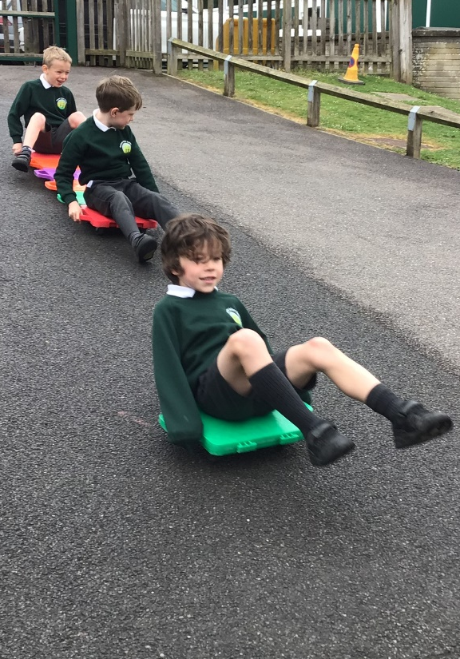
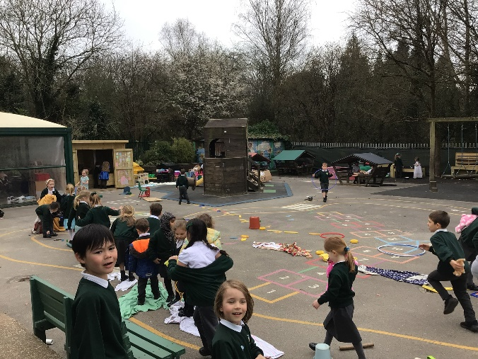
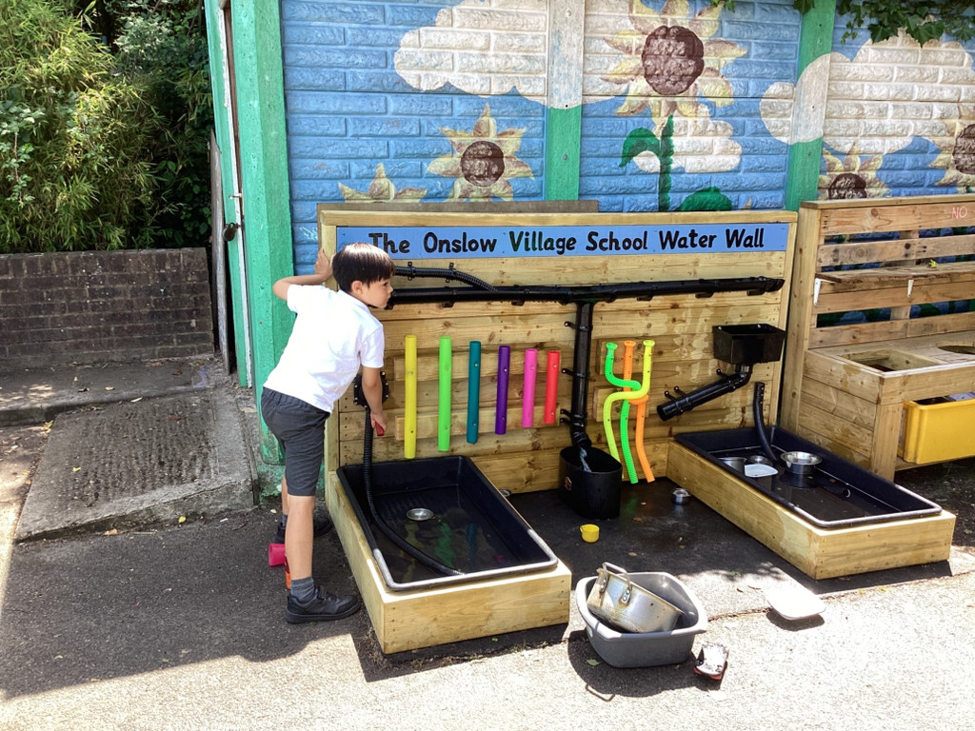
OPAL
We are an OPAL school (outdoor play and learning).
Our pupils are trusted to manage risk and follow their own ideas at lunchtime, supported by adults where needed.
Notes:
*know that print is read from left to right and top to bottom
characters, sequence of events, story language
How info can be found in n-f bks
, leading to sentences
*to represent sounds correctly in writing
*to attempt writing for a variety of purposes

Slide 14
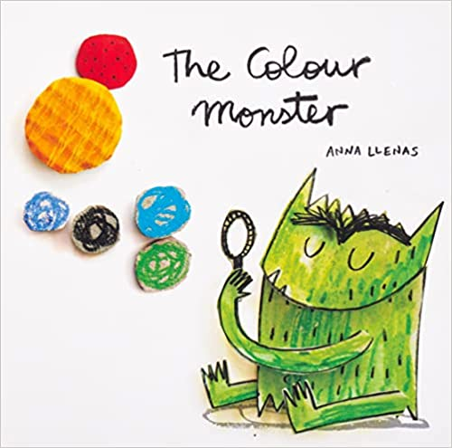
Supporting every child
Colour monster book to discuss emotions - great to use at home too
Set phrases to help your child communicate their needs at school:
  “Help me please”
  “Stop I don’t like it”
  “Can I go to the toilet?”
  Teach your child to tell us straight away if something happens so we can help them (we will also have worry monsters in every class)
Notes:
*know that print is read from left to right and top to bottom
characters, sequence of events, story language
How info can be found in n-f bks
, leading to sentences
*to represent sounds correctly in writing
*to attempt writing for a variety of purposes

Slide 15
Any questions?

