Slide 1
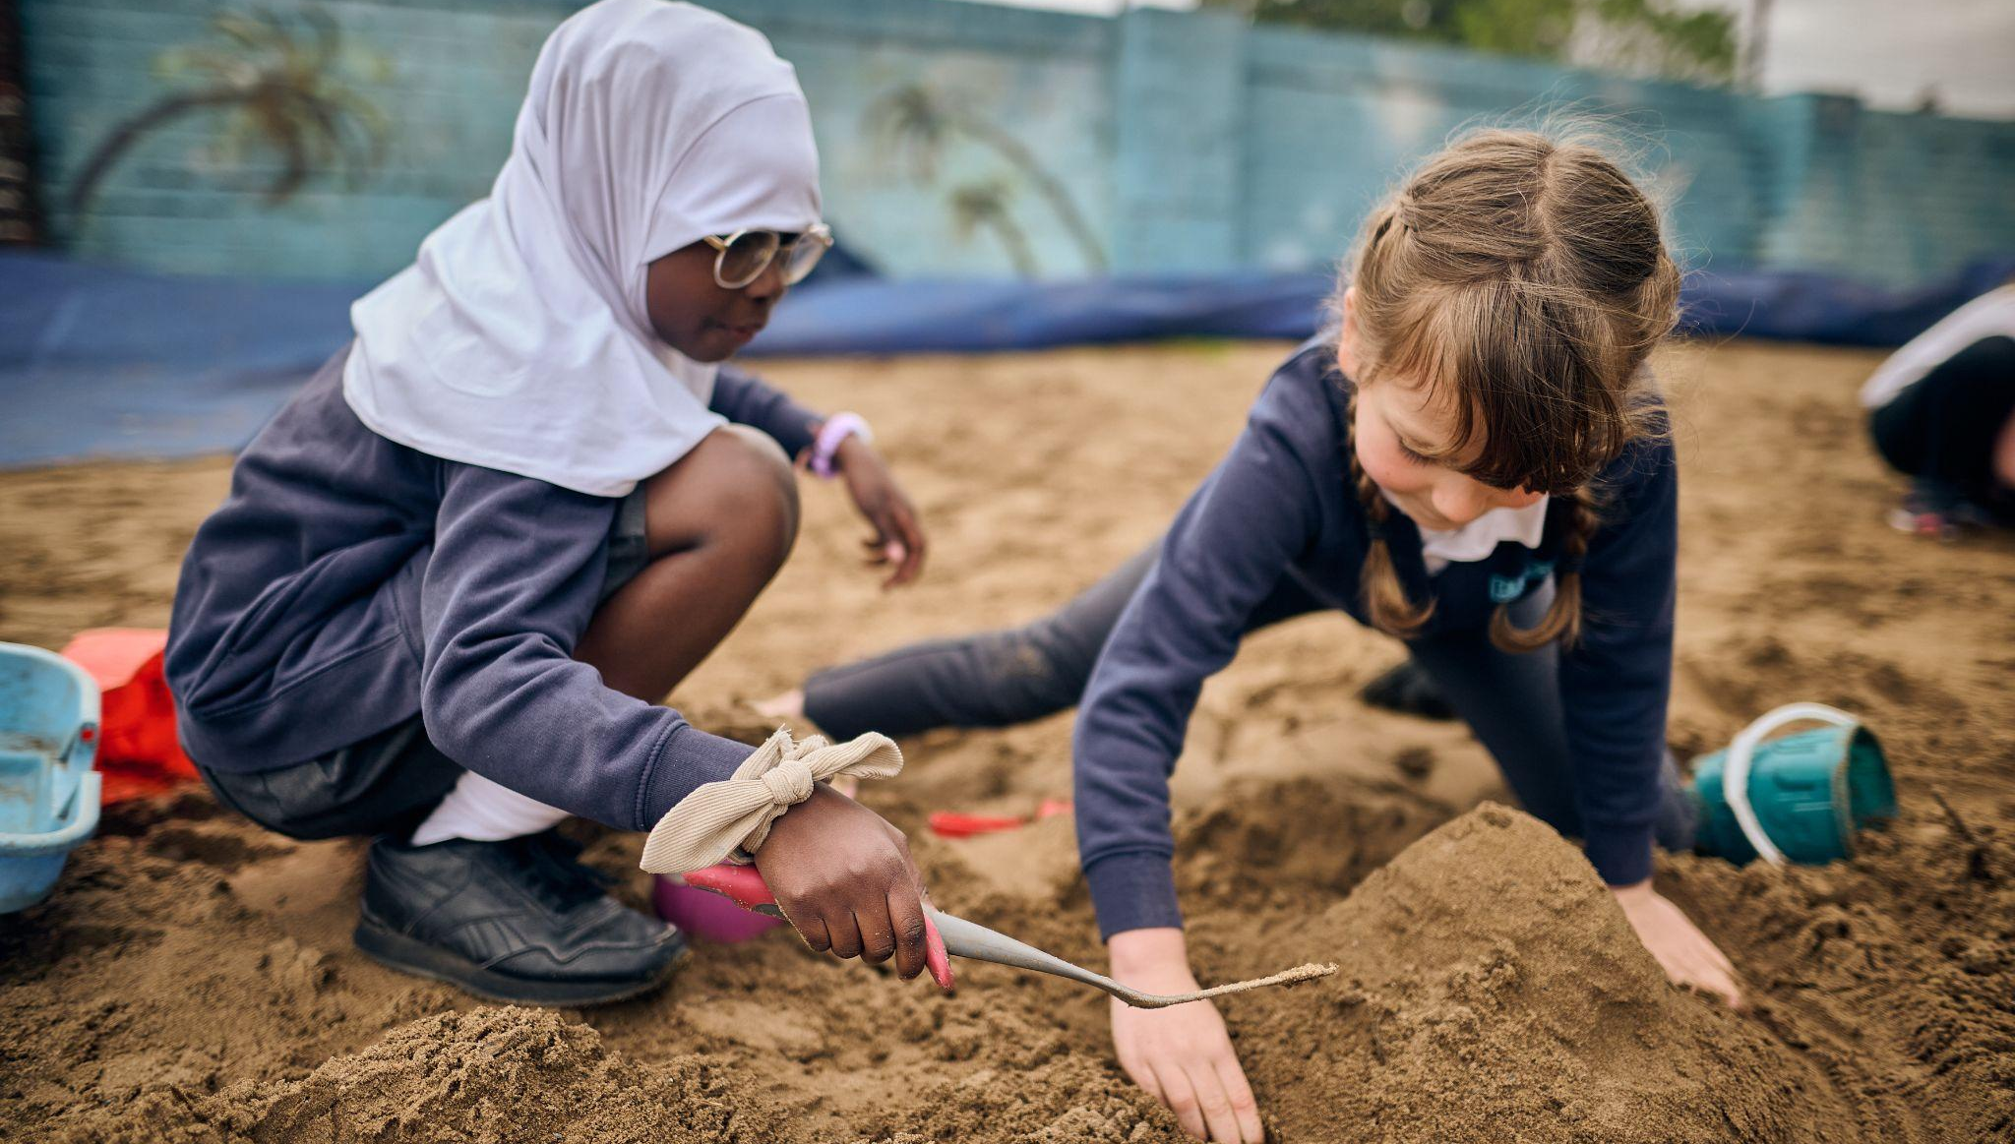


Outdoor Play and Learning (OPAL)

Slide 2
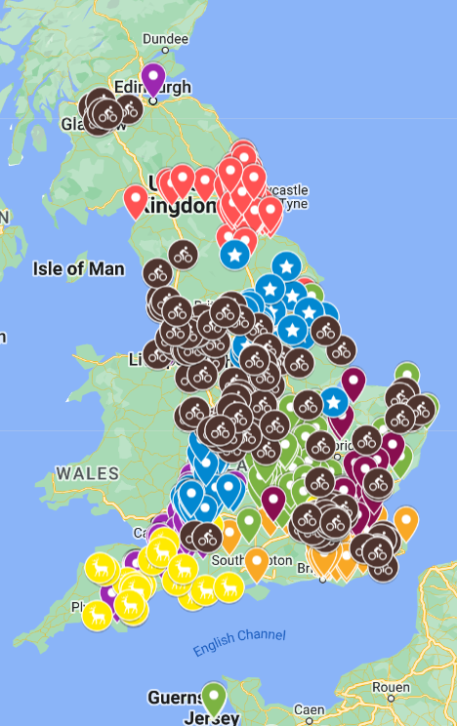



Do we know it works?
OPAL is a UK and world leader in supporting schools to improve the quality of children’s play.
Our mission is for every primary school child to have an amazing playtime, every day, with no exceptions!
Our delivery
Almost 2,000 schools and over 2 million children have benefited;
Projects in Canada, New Zealand, Australia, France, Malaysia, the USA and Poland.
Citations: National Children’s Bureau; Public Health England; All Party Parliamentary Group on Childhood; Cambridge University PEDAL (Play Education Development and Learning); Sport England.
Supporting school improvement through play
www.outdoorplayandlearning.org.uk
© OPAL CIC 2025
@OPAL_CIC
OpalOutdoorplay

Slide 3

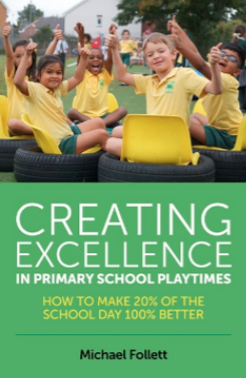

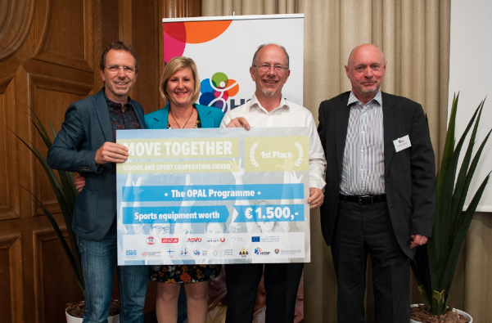



Outdoor play in primary schools
Supporting school improvement through play
www.outdoorplayandlearning.org.uk
© OPAL CIC 2025
@OPAL_CIC
OpalOutdoorplay

Slide 4
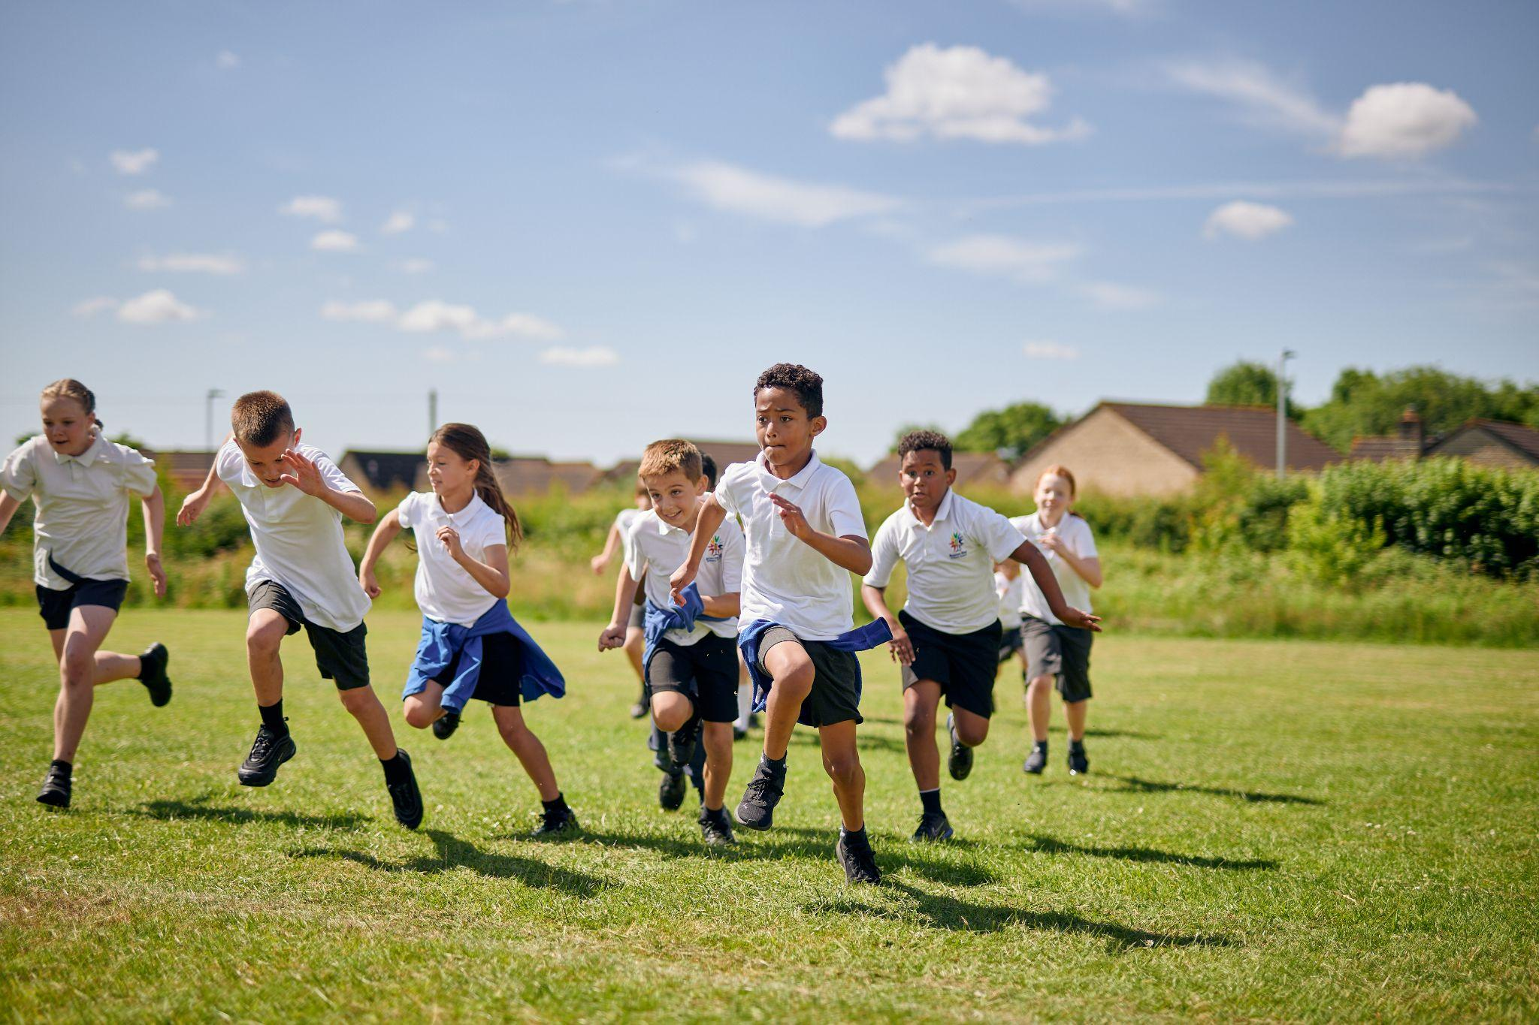
Amazing playtimes, for every child, every day

Slide 5
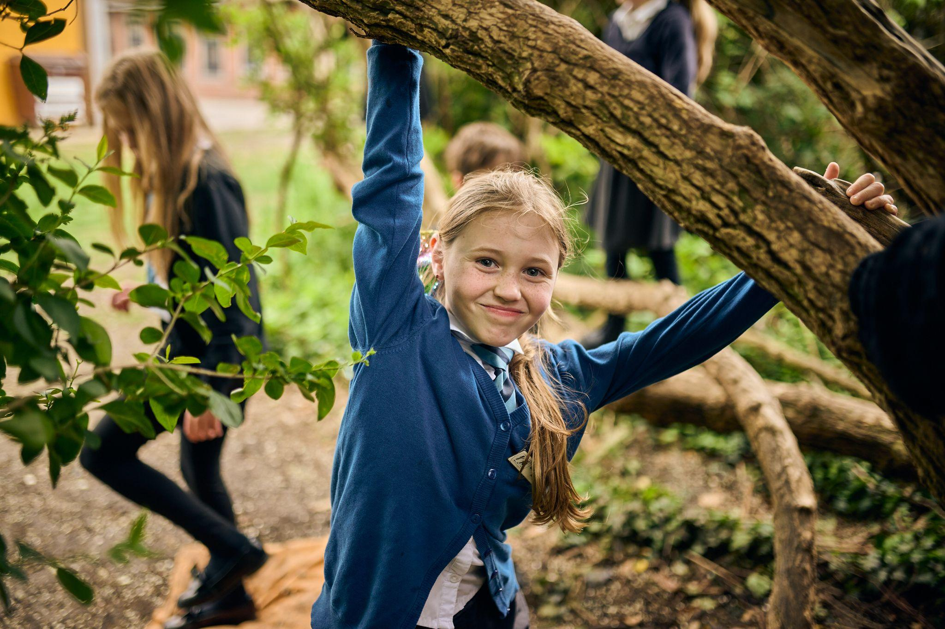

Childhood has changed – children have not!
Let’s think about play.
At 10 years old…
Where were you, who were you with, what were you up to?
Supporting school improvement through play
www.outdoorplayandlearning.org.uk
© OPAL CIC 2025
@OPAL_CIC
OpalOutdoorplay

Slide 6
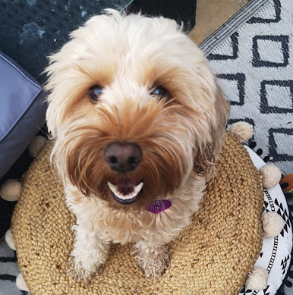
Here’s a thought…
For a good quality of life, what does Lottie need?
Supporting school improvement through play
www.outdoorplayandlearning.org.uk
© OPAL CIC 2025
@OPAL_CIC
OpalOutdoorplay

Slide 7
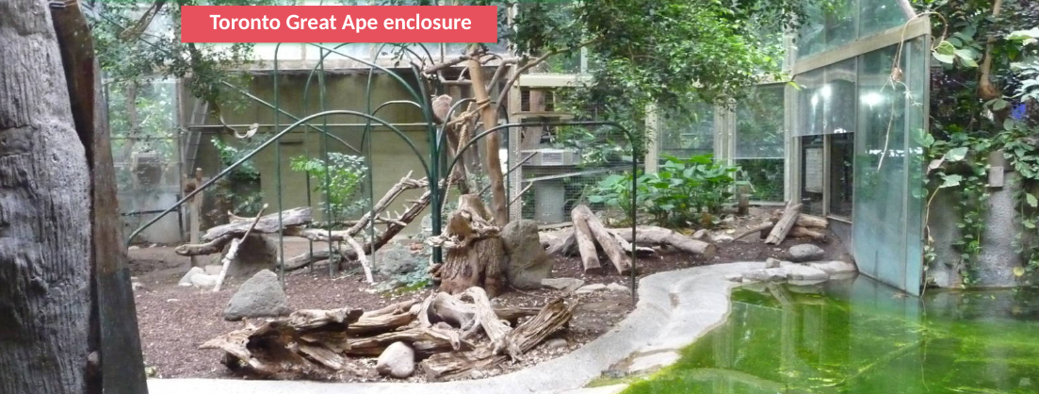
How does this enclosure meet the needs of the great apes?
Supporting school improvement through play
www.outdoorplayandlearning.org.uk
© OPAL CIC 2025
@OPAL_CIC
OpalOutdoorplay

Slide 8
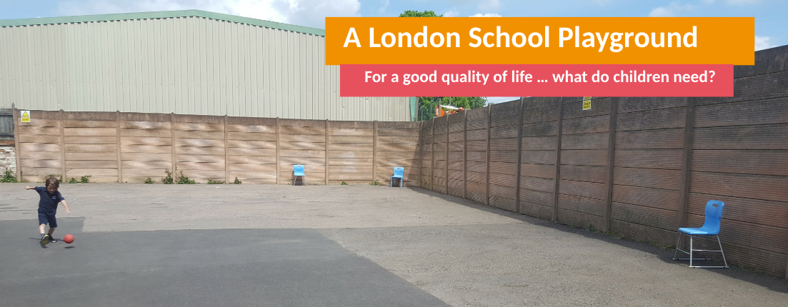
How does this meet the needs of children?
We are the gatekeepers of children’s experience: we can control, restrict or provide access, permission, time, space, and opportunities
Supporting school improvement through play
www.outdoorplayandlearning.org.uk
© OPAL CIC 2025
@OPAL_CIC
OpalOutdoorplay

Slide 9
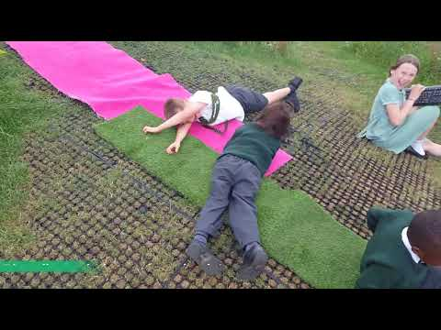
Amazing playtime at St Michael's – a platinum OPAL school
Supporting school improvement through play
www.outdoorplayandlearning.org.uk
© OPAL CIC 2025
@OPAL_CIC
OpalOutdoorplay

Slide 10
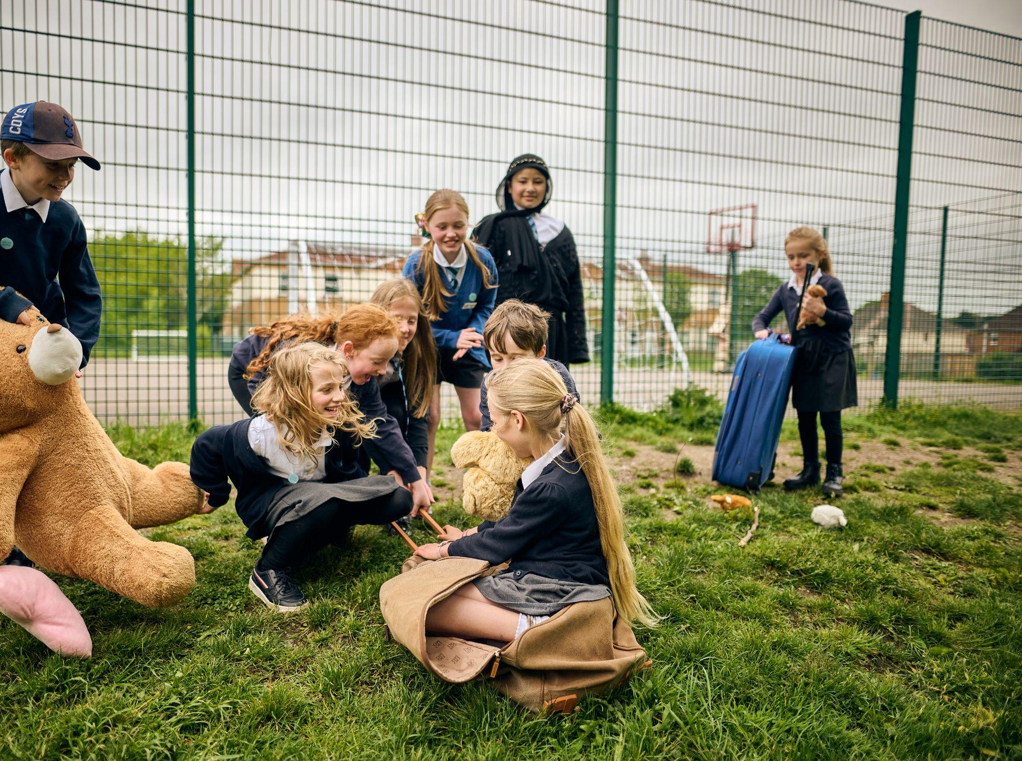
Integration
New friendships
Inclusion
Social skills
Non-judgemental
No age restrictions
No gender bias
Supporting school improvement through play
www.outdoorplayandlearning.org.uk
© OPAL CIC 2025
@OPAL_CIC
OpalOutdoorplay

Slide 11
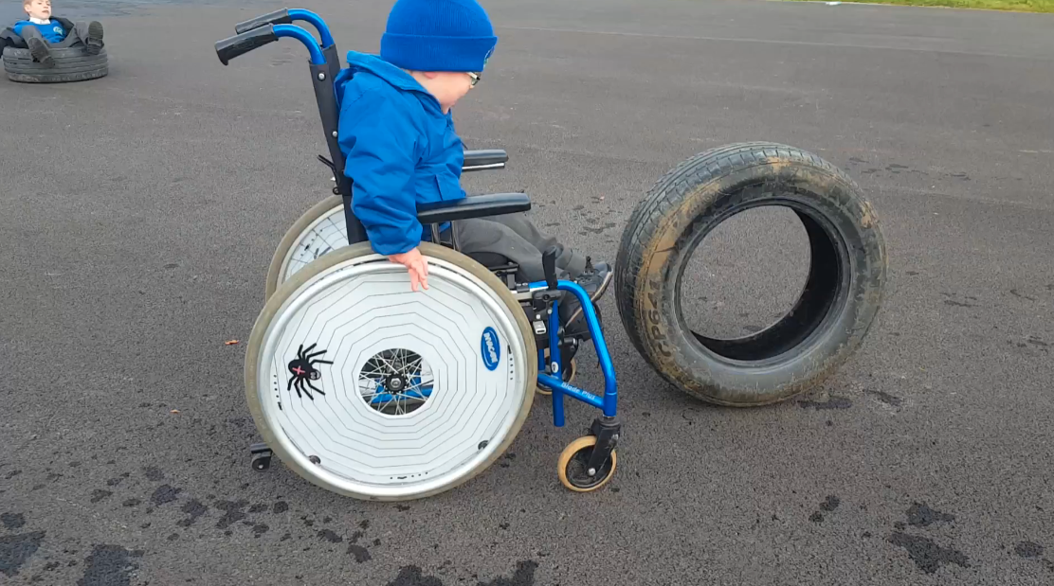
Inclusion – access for all
Supporting school improvement through play
www.outdoorplayandlearning.org.uk
© OPAL CIC 2025
@OPAL_CIC
OpalOutdoorplay

Slide 12
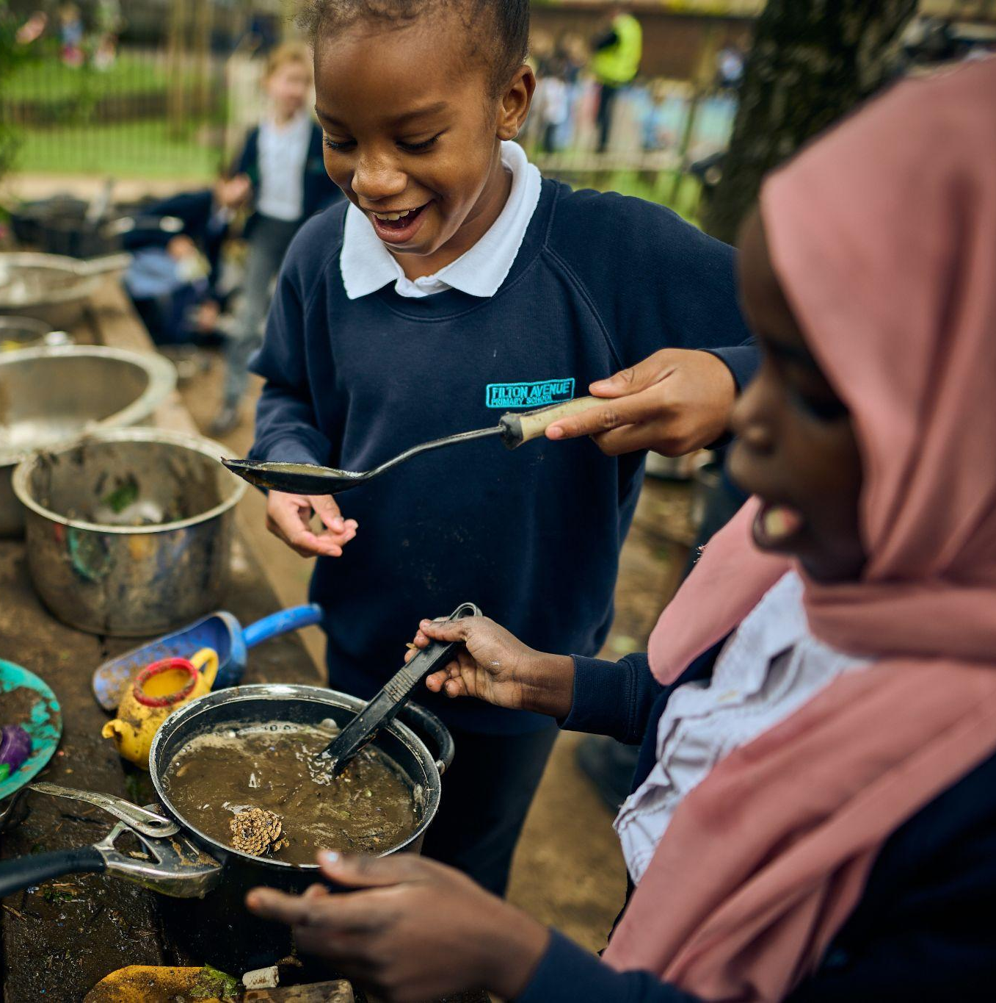
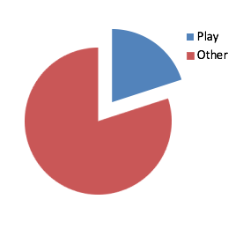
Play makes up 20% of school life
Per year
231 hours
37 days
7.4 weeks
Primary years
1.4 years
Supporting school improvement through play
www.outdoorplayandlearning.org.uk
© OPAL CIC 2025
@OPAL_CIC
OpalOutdoorplay

Slide 13

The unteachable curriculum
We don’t have to choose between play and learning.
Supporting school improvement through play
www.outdoorplayandlearning.org.uk
© OPAL CIC 2025
@OPAL_CIC
OpalOutdoorplay

Slide 14
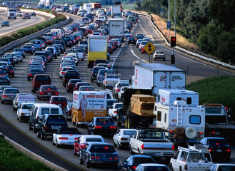
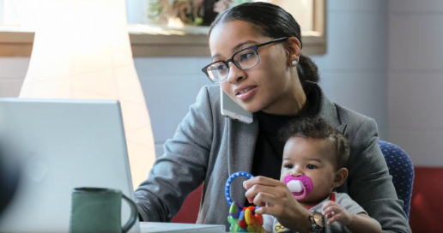
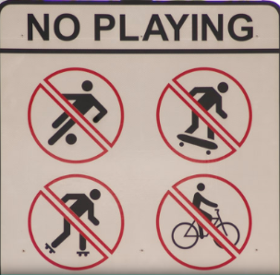

Changes to childhood
Culture of fear
Traffic
Obesity
Working parents
Mental health problems
Lack of resilience
Structured lives
No ball games
Technology
Supporting school improvement through play
www.outdoorplayandlearning.org.uk
© OPAL CIC 2025
@OPAL_CIC
OpalOutdoorplay

Slide 15
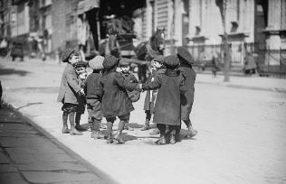
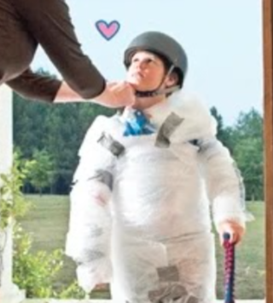
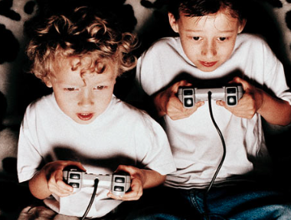
Childhood has changed, children have not
UK children’s screen time is an average six hours per day.
“By the age of seven the average child will have spent a full year of 24-hour days watching recreational screen media.” Dr Aric Sigman
Supporting school improvement through play
www.outdoorplayandlearning.org.uk
© OPAL CIC 2025
@OPAL_CIC
OpalOutdoorplay

Slide 16



Resilience and emotional regulation
Children build resilience by overcoming challenges and fear.
Resilience isn’t a biological gift from great parents… it is something we need to gain through experience.
Supporting school improvement through play
www.outdoorplayandlearning.org.uk
© OPAL CIC 2025
@OPAL_CIC
OpalOutdoorplay

Slide 17
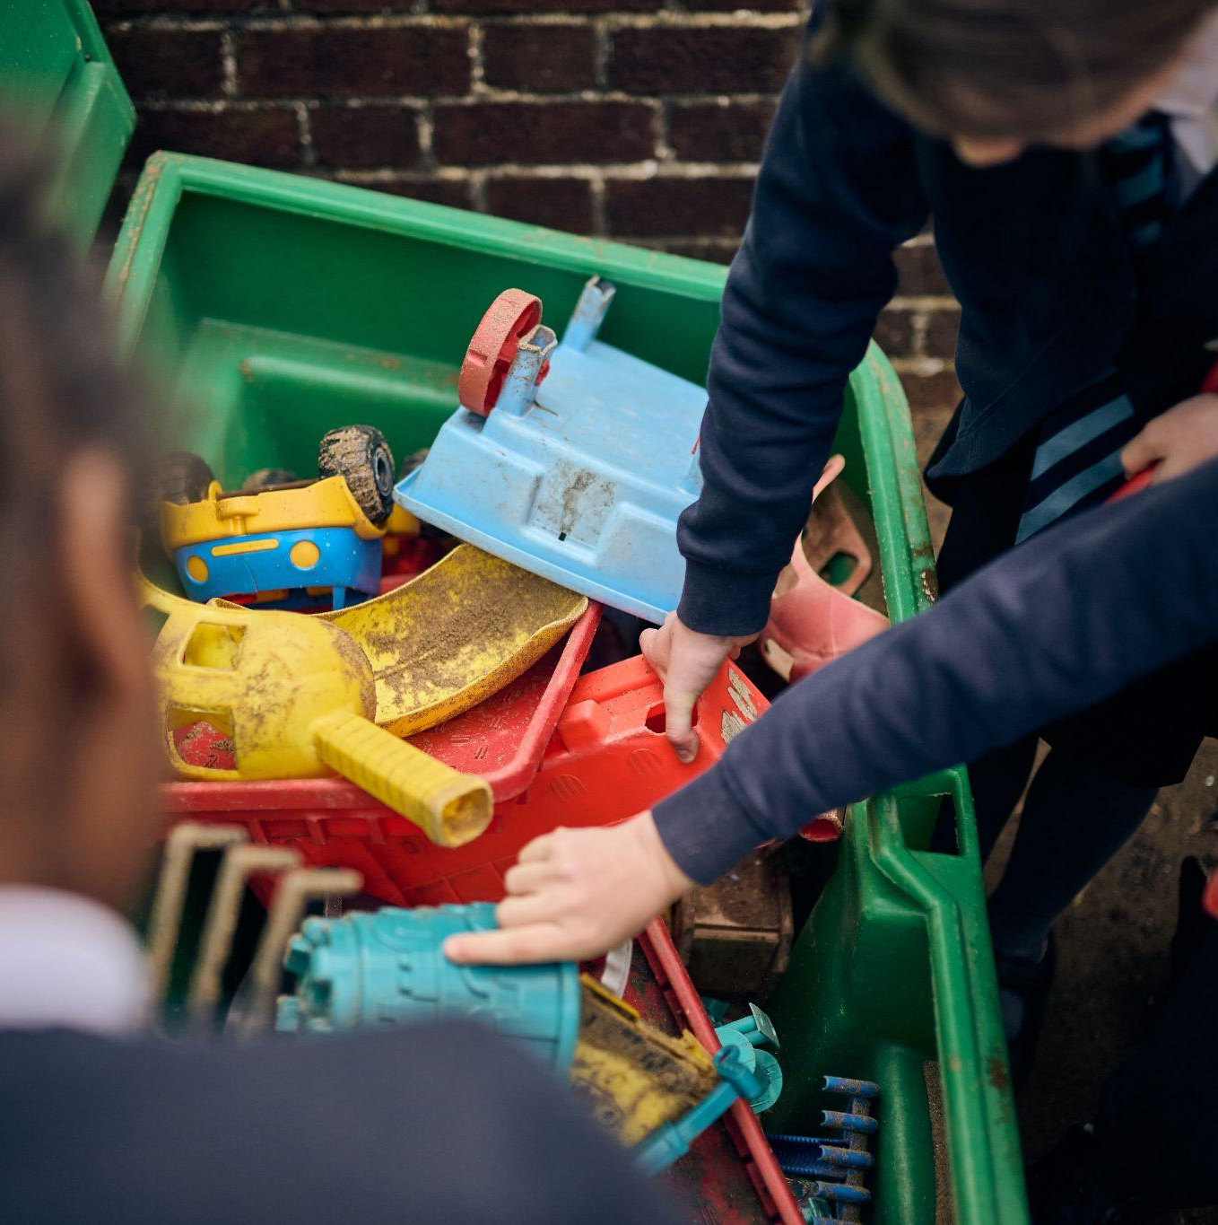
What is play?
Play is a process that is:
Freely chosen
Intrinsically motivated
Self-directed
Supporting school improvement through play
www.outdoorplayandlearning.org.uk
© OPAL CIC 2025
@OPAL_CIC
OpalOutdoorplay

Slide 18
The benefits of play
Communication skills
Literacy
Numeracy
Artistic creativity
Narrative skills
Social and group work skills
Understanding rules
Discussion skills
Mental representation
Strength and endurance
Whole body coordination
Emotional attachment
Emotional and social skills
Hand-eye coordination
Thinking, reasoning, problem solving
Early language development
Self-regulation: The ability to be aware of and regulate one’s own cognitive and emotional mental states and behaviour.
Supporting school improvement through play
www.outdoorplayandlearning.org.uk
© OPAL CIC 2025
@OPAL_CIC
OpalOutdoorplay

Slide 19
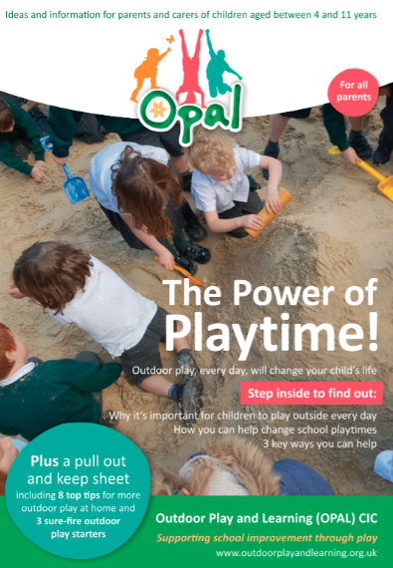
Health benefits for all the family
Exercise
Family time
Fun
Improved mental health
Fresh air
Relaxation
Feel good factor
Parent’s booklet… it’s free and full of great ideas!
Supporting school improvement through play
www.outdoorplayandlearning.org.uk
© OPAL CIC 2025
@OPAL_CIC
OpalOutdoorplay

Slide 20
Adult intervention… playwork style
Hinders
Be careful
You’re going to hurt yourself
That’s too big for you
Passes on own anxiety
Distracts child from engaging in certain play types
Adulterates play - gets over involved/excited
Over competitive
Allows child to always win
Helpful
Supportive
Models behaviour
Follows child’s direction
Provides resources
Thinks about when to intervene
Waits to be invited
Observes
Learns and reflects
We don’t always get it right!
Supporting school improvement through play
www.outdoorplayandlearning.org.uk
© OPAL CIC 2025
@OPAL_CIC
OpalOutdoorplay

Slide 21
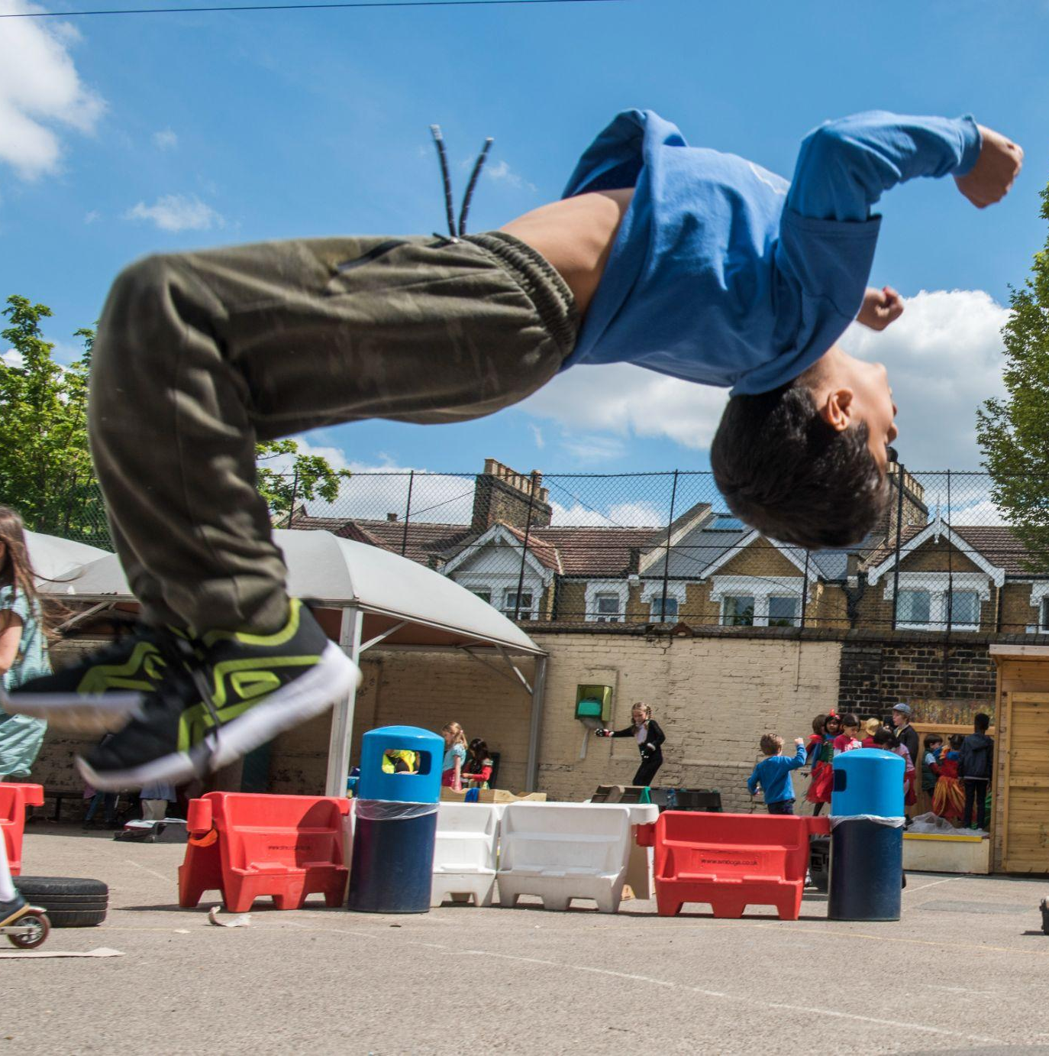
The importance of risk in children’s play
Risk means going beyond what is already known and easily accomplished.
Supporting school improvement through play
www.outdoorplayandlearning.org.uk
© OPAL CIC 2025
@OPAL_CIC
OpalOutdoorplay

Slide 22

Children’s play and leisure - promoting a balanced approach (Sep 2012)
In 2012 the HSE worked with the UK’s Play Safety forum to agree this guidance.
Source: https://www.hse.gov.uk/entertainment/childs-play-statement.htm
“Play is great for children’s wellbeing and development.”
Striking the right balance means:
Weighing up risks and benefits.
Focusing on and controlling the most serious risk.
Recognising that the introduction of risk might form part of play opportunities and activity.
Understanding that the purpose of risk control is not the elimination of all risk.
Ensuring that the benefits of play are experienced to the full.
“When planning and providing play opportunities, the goal is not to eliminate risk, but to weigh up the risks and the benefits.”
“No child will learn about risk if they are wrapped in cotton wool.”
Supporting school improvement through play
www.outdoorplayandlearning.org.uk
© OPAL CIC 2025
@OPAL_CIC
OpalOutdoorplay

Slide 23
How do we develop play in school?
Policy and planning
They are making sure improving play is always part of their planning.
Improving space and access
Children will be able to access a great environment all year.
Risk-benefit approach
They will balance challenge and exploration with sensible care.
Knowledge
Their staff will use playwork skills to improve their practice and the environment.
Communication
They will keep talking to children, parents and staff about play.
Supporting school improvement through play
www.outdoorplayandlearning.org.uk
© OPAL CIC 2025
@OPAL_CIC
OpalOutdoorplay

Slide 24
The impact of OPAL
More physically active more of the year.
Developing life skills – resilience, competencies.
Risk management skills, improved decision making.
Social skills, team building, negotiation.
Improved mental health and wellbeing.
100% girls more active.
Huge core skills improvement.
Improved behaviour.
Less accidents, incidents and whinging.
More inclusive. No child bored or feeling left out.
Increased learning time. More settled and ready to learn.
Cost saving – SLT and teachers’ time.
Supporting school improvement through play
www.outdoorplayandlearning.org.uk
© OPAL CIC 2025
@OPAL_CIC
OpalOutdoorplay

Slide 25
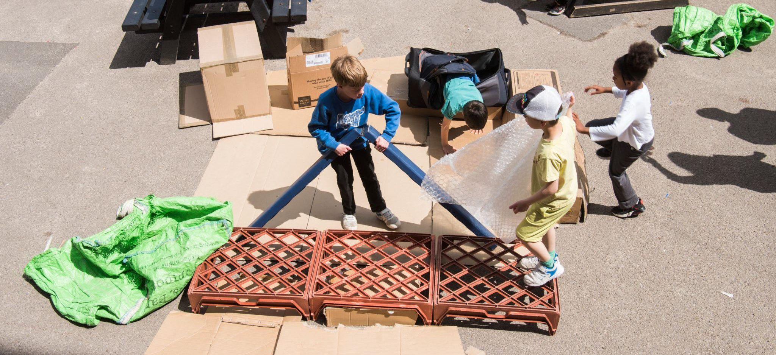
Creating a playful environment – outdoor loose parts
Supporting school improvement through play
www.outdoorplayandlearning.org.uk
© OPAL CIC 2025
@OPAL_CIC
OpalOutdoorplay

Slide 26
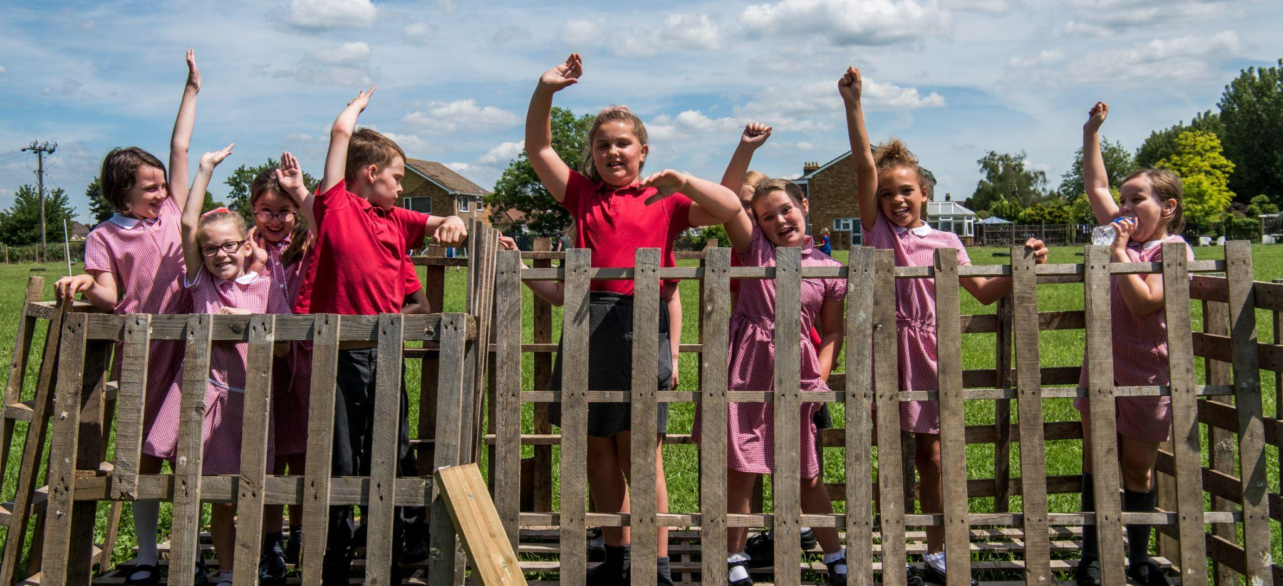
Imagination, creativity and teamwork
Supporting school improvement through play
www.outdoorplayandlearning.org.uk
© OPAL CIC 2025
@OPAL_CIC
OpalOutdoorplay

Slide 27
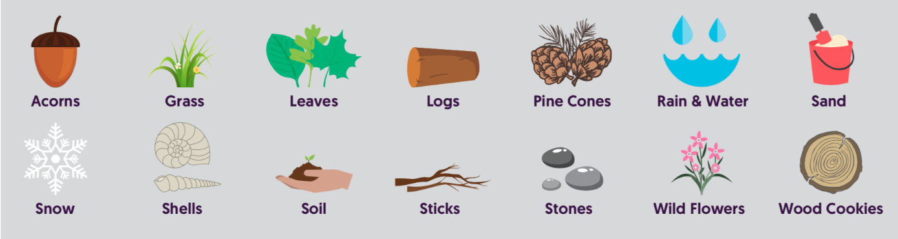
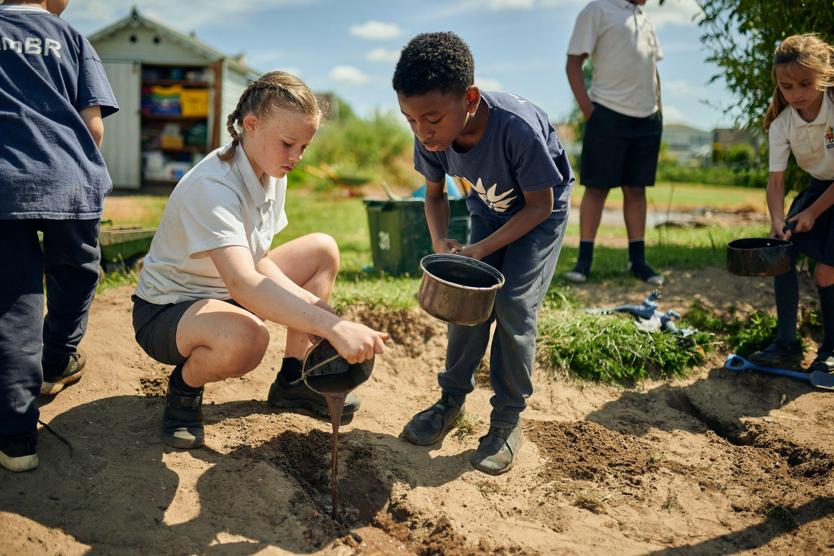
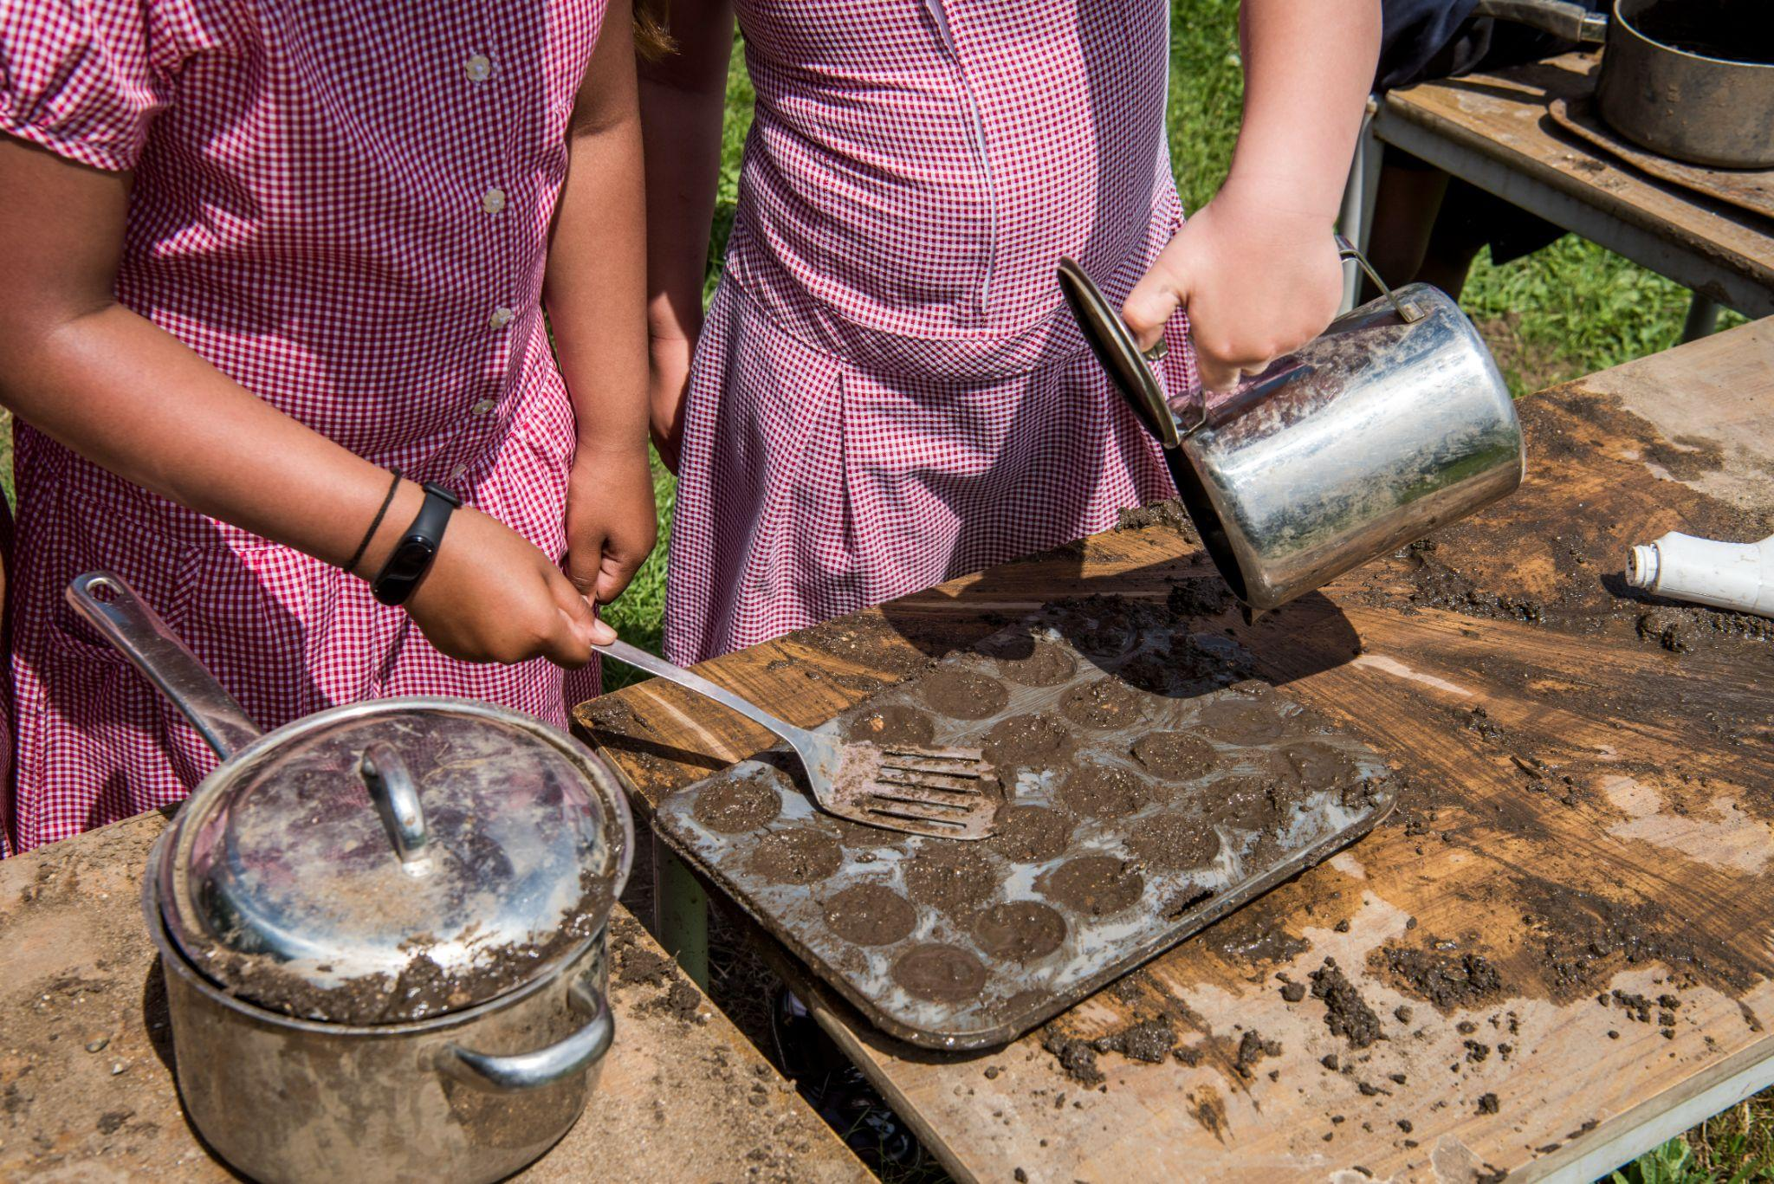
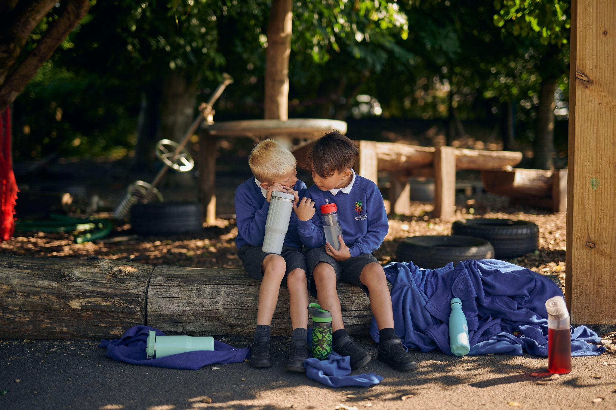
Natural loose parts
Supporting school improvement through play
www.outdoorplayandlearning.org.uk
© OPAL CIC 2025
@OPAL_CIC
OpalOutdoorplay

Slide 28
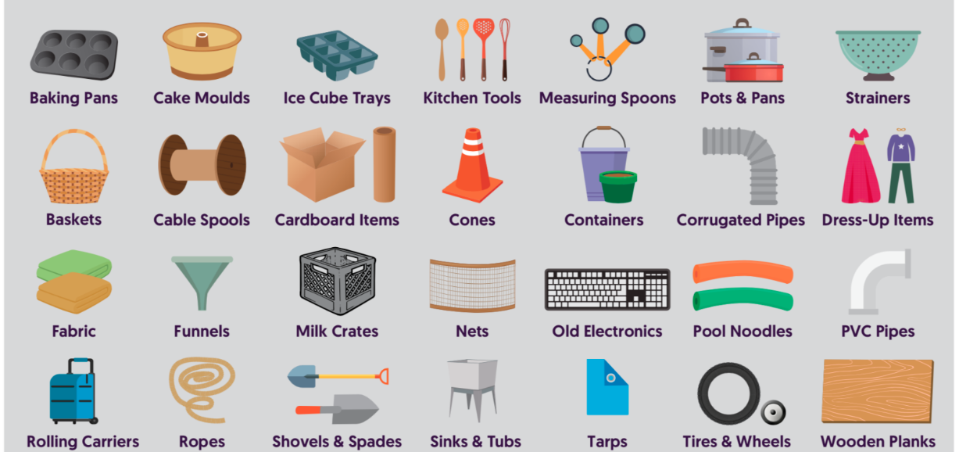
We still need your upcycled loose parts
Thank you – please keep sending in resources for playtime!
Supporting school improvement through play
www.outdoorplayandlearning.org.uk
© OPAL CIC 2025
@OPAL_CIC
OpalOutdoorplay

Slide 29
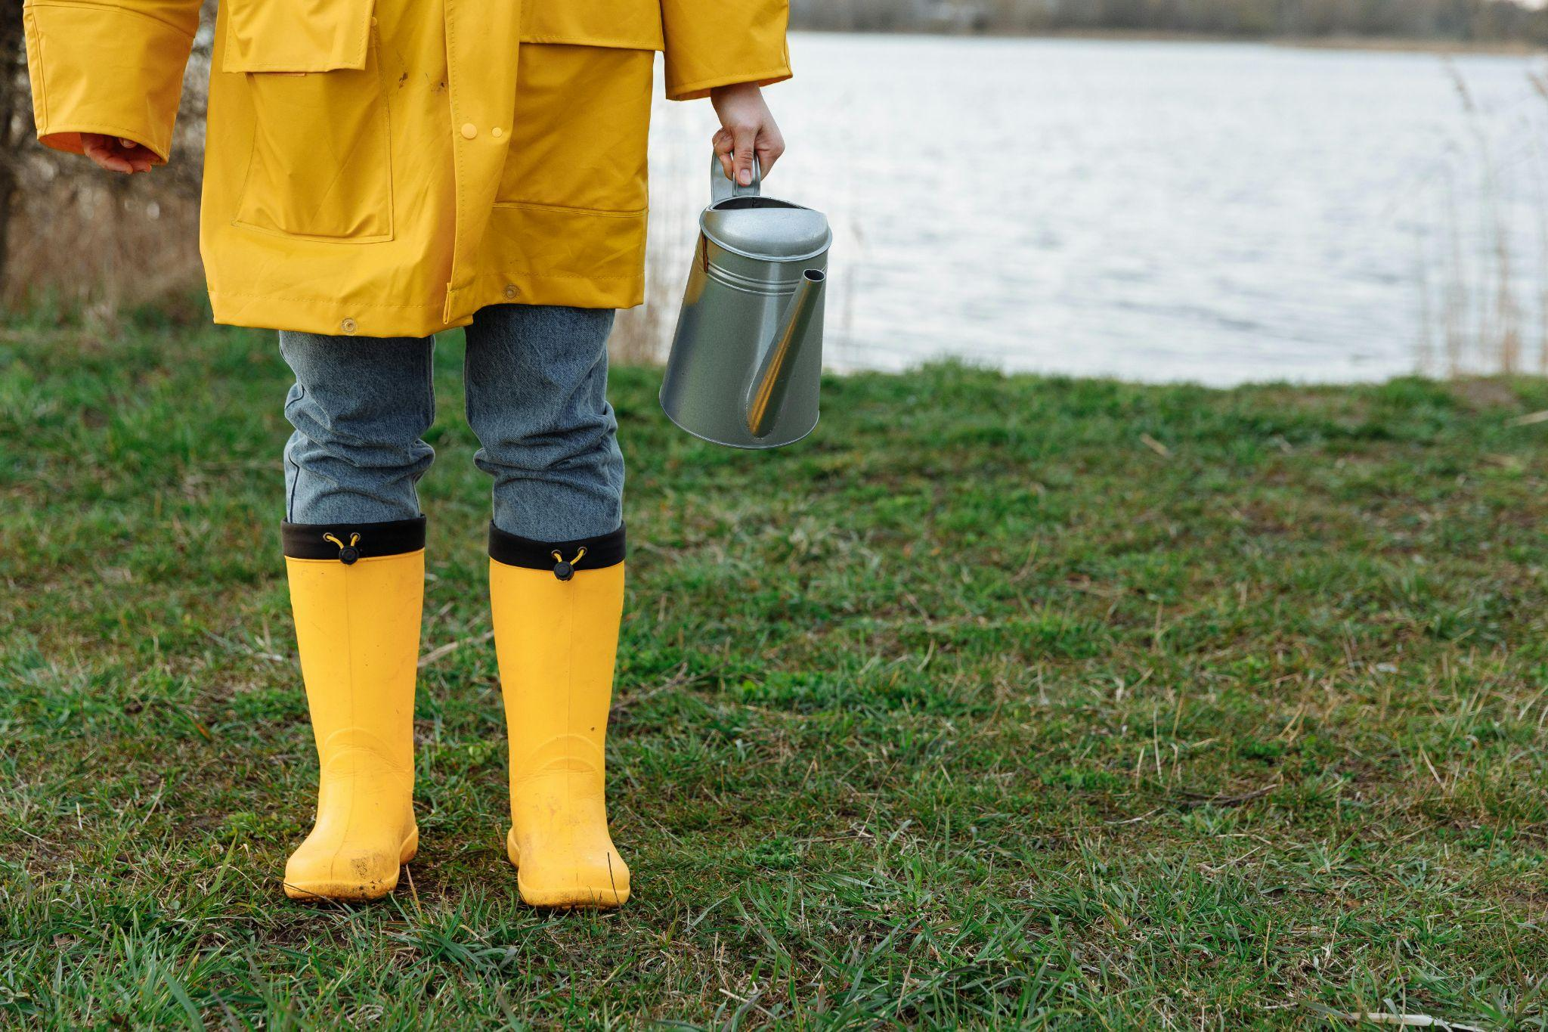
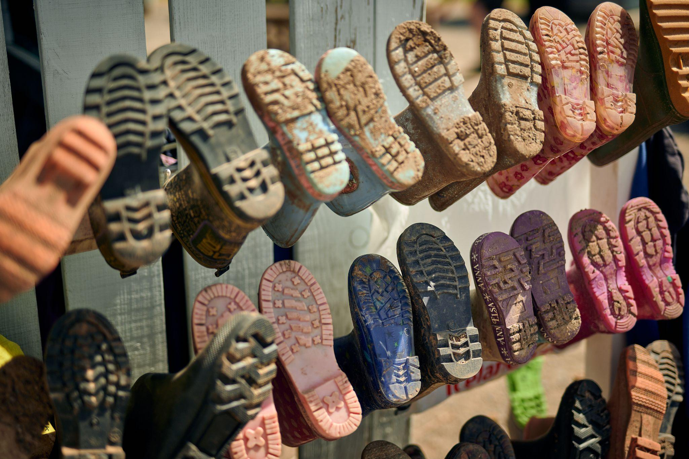
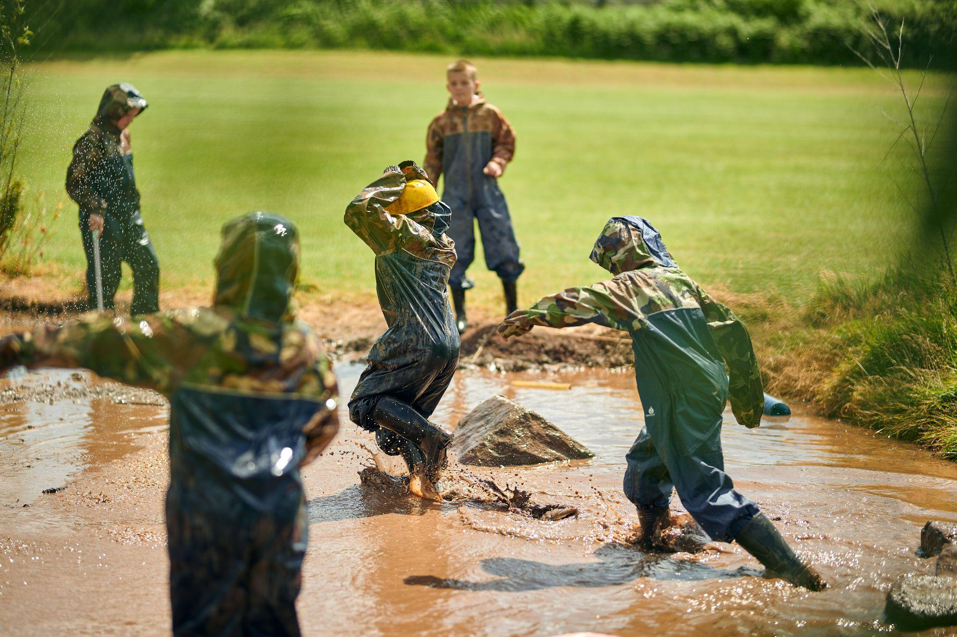
The essentials
A waterproof coat
A pair of wellies
Tolerance of dirt and mud
Outdoor play is essential to your child’s health and wellbeing.
Supporting school improvement through play
www.outdoorplayandlearning.org.uk
© OPAL CIC 2025
@OPAL_CIC
OpalOutdoorplay

Slide 30
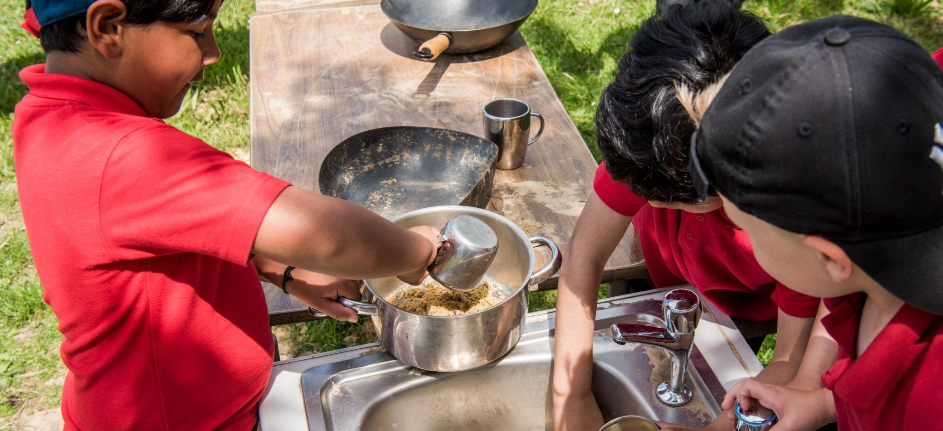
No age restriction on a mud kitchen
Supporting school improvement through play
www.outdoorplayandlearning.org.uk
© OPAL CIC 2025
@OPAL_CIC
OpalOutdoorplay

Slide 31
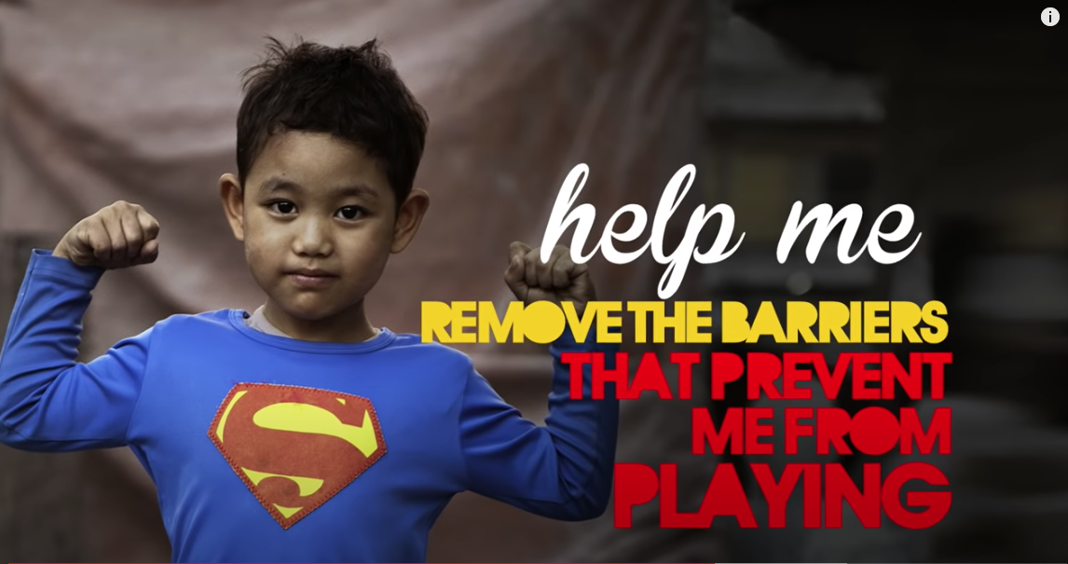
Supporting school improvement through play
www.outdoorplayandlearning.org.uk
© OPAL CIC 2025
@OPAL_CIC
OpalOutdoorplay

Slide 32
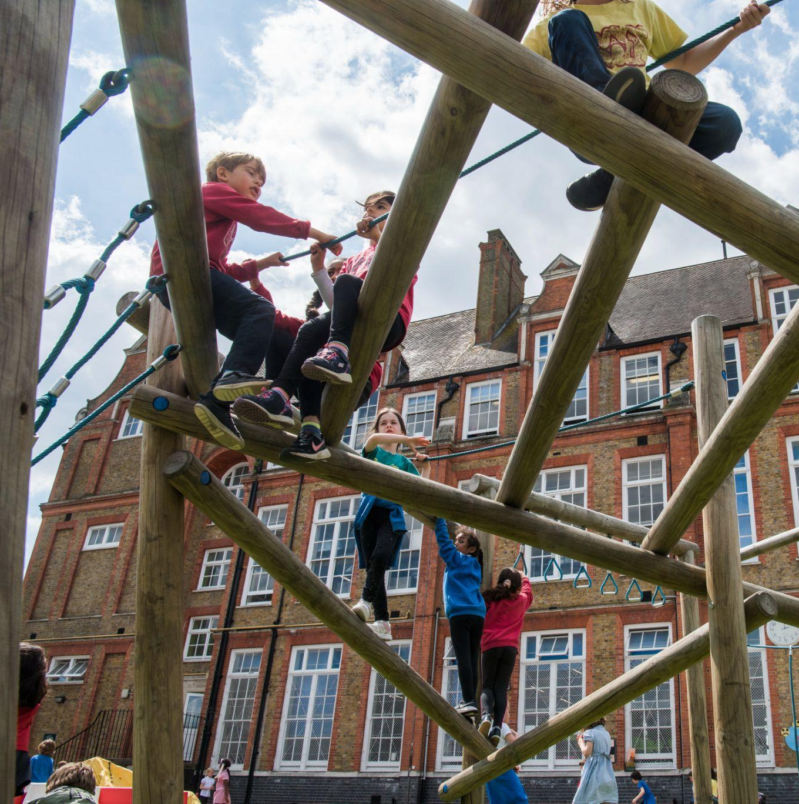
Time to play
Staff are outside if you have any questions.
Let the children show you around.
Let the children lead.
Help yourself to resources.
Join in if invited!
Have fun!
Supporting school improvement through play
www.outdoorplayandlearning.org.uk
© OPAL CIC 2025
@OPAL_CIC
OpalOutdoorplay

Slide 33
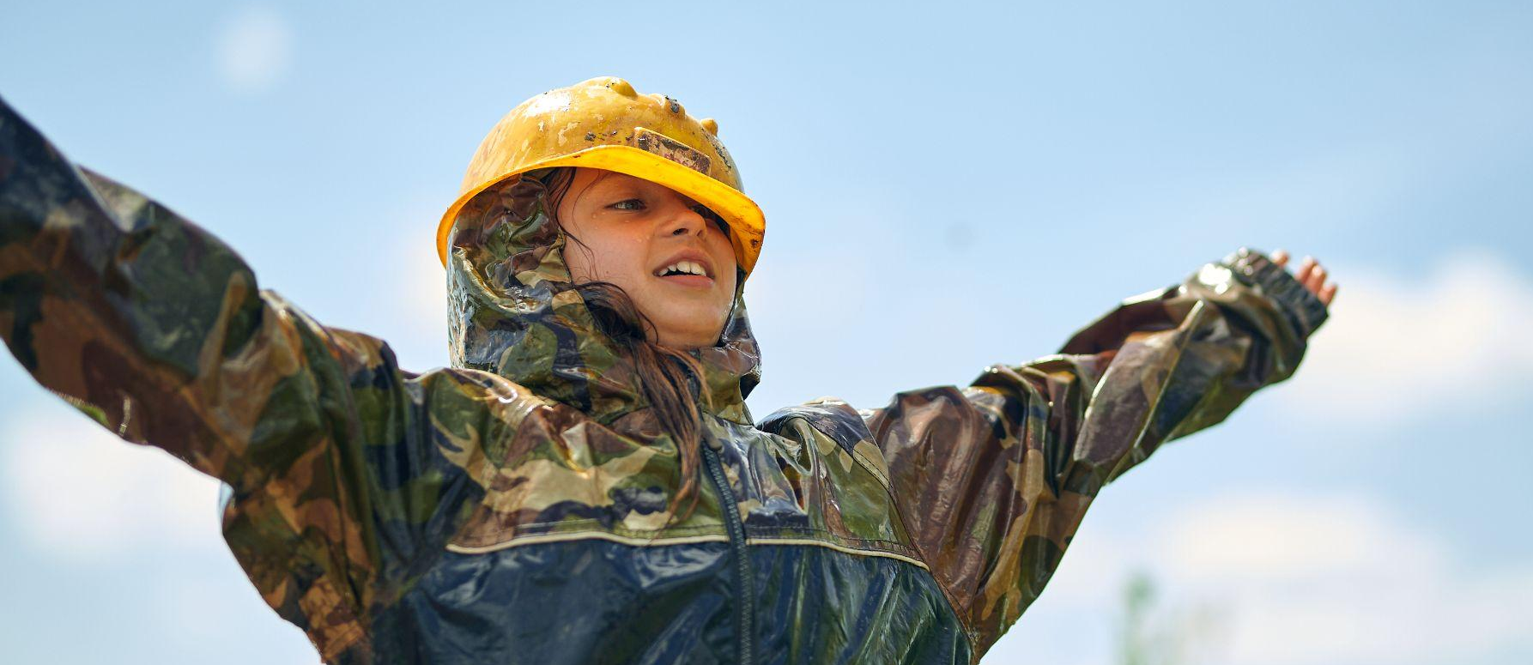
Thank you for reading!
Your OPAL journey is about to begin!
For further information, contact Mrs Pardoe
Supporting school improvement through play
www.outdoorplayandlearning.org.uk
© OPAL CIC 2025
@OPAL_CIC
OpalOutdoorplay

